Slide 1

Distributed & Cloud Computing
Welcome
Sukkur IBA University
Week – 06
Lecture – 11&12
Your Facilitator, Adil Khan

Slide 2
Containerization

Slide 3
Containers
Containerization is the packaging of software code with just the operating system (OS) libraries and dependencies required to run the code to create a single lightweight executable—called a container—that runs consistently on any infrastructure.
Containerization is defined as a form of operating system virtualization, through which applications are run in isolated user spaces called containers, all using the same shared operating system (OS).
Containerization allows developers to create and deploy applications faster and more securely.

Slide 4
Containers
With traditional methods, code is developed in a specific computing environment which, when transferred to a new location, often results in bugs and errors.
For example, when a developer transfers code from a desktop computer to a virtual machine (VM) or from a Linux to a Windows operating system.
Containerization eliminates this problem by bundling the application code together with the related configuration files, libraries, and dependencies required for it to run.
This single package of software or “container” is abstracted away from the host operating system, and hence, it stands alone and becomes portable—able to run across any platform or cloud, free of issues.

Slide 5
Containers
Containers are often referred to as “lightweight,” meaning they share the machine’s operating system kernel and do not require the overhead of associating an operating system within each application.
Containers are inherently smaller in capacity than a VM and require less start-up time, allowing far more containers to run on the same compute capacity as a single VM.
Perhaps most important, containerization allows applications to be “written once and run anywhere.”
This portability speeds development, prevents cloud vendor lock-in and offers other notable benefits such fault isolation, ease of management, simplified security and more.

Slide 6
Containers
Encapsulate an application
Container layers can be shared.
Portable across many platforms.
Enterprises rapidly adaption containerization for development and management.
Notes:
Containers encapsulate an application as a single executable package of software that bundles application code together with all of the related configuration files, libraries, and dependencies required for it to run. Containerized applications are “isolated” in that they do not bundle in a copy of the operating system. Instead, an open source runtime engine (such as the Docker runtime engine) is installed on the host’s operating system and becomes the conduit for containers to share an operating system with other containers on the same computing system.
Other container layers, like common bins and libraries, can also be shared among multiple containers. This eliminates the overhead of running an operating system within each application and makes containers smaller in capacity and faster to start up, driving higher server efficiencies. The isolation of applications as containers also reduces the chance that malicious code present in one container will impact other containers or invade the host system.
The abstraction from the host operating system makes containerized applications portable and able to run uniformly and consistently across any platform or cloud. Containers can be easily transported from a desktop computer to a virtual machine (VM) or from a Linux to a Windows operating system, and they will run consistently on virtualized infrastructures or on traditional “bare metal” servers, either on-premise or in the cloud. This ensures that software developers can continue using the tools and processes they are most comfortable with.

Slide 7
Virtualization vs. Containerization

Slide 8
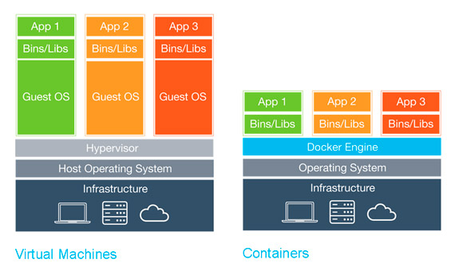
Virtualization vs. Containerization
Notes:
Details from last layer to upper layer

Slide 9
Virtualization vs. Containerization
Each container image could be only a few megabytes in size, making it easier to share, migrate, and move.
A container engine can easily manage large number of containers so we can create, add, and remove containers as needed.
The maintenance of containers is also simplified since we need to update and fix bugs on only one operating system.
Containers decrease hardware costs since the allocation of multiple applications to the same hardware improves hardware utilization.
Notes:
Details from last layer to upper layer

Slide 10
Speed/ Efficiency
Containers are often referred to as “lightweight,” meaning they share the machine’s operating system (OS) kernel.
The containers starts immediately, since the OS is already running, so the application will start up without any delay.
On the other hand, Virtual machines (VMs) need to start entire OS, which includes a full boot process.
It will take much longer than it would take for container.

Slide 11
Resources
VM uses more resources as virtual servers run separate OS.
VMs consumes memory even when they are not running any user process.
Hence, certain amount of overhead is created, causes more resources to be used.
When it comes to containers, they can startup pretty quickly, so their memory consumption doesn’t increase.

Slide 12
Portability
Container images are much smaller than virtual machines, they are easy to transfer and save space on the host’s file system.
VMs, on the other hand, need to have a copy of whole OS, including kernel, system libraries, and configuration files etc.
A container creates an executable package of software that is abstracted away from (not tied to or dependent upon) the host operating system, and hence, is portable and able to run uniformly and consistently across any platform or cloud.

Slide 13
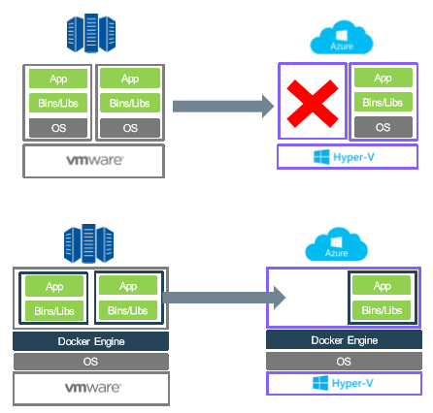
Portability

Slide 14
Security and Isolation
Each VM can incorporate its own security protocols since they are running in a fully isolated environment.
One infected VM will not affect another one.
Containers only isolate data and applications at the process level, they provide less secure environment and depend on the security protocols of host system.

Slide 15
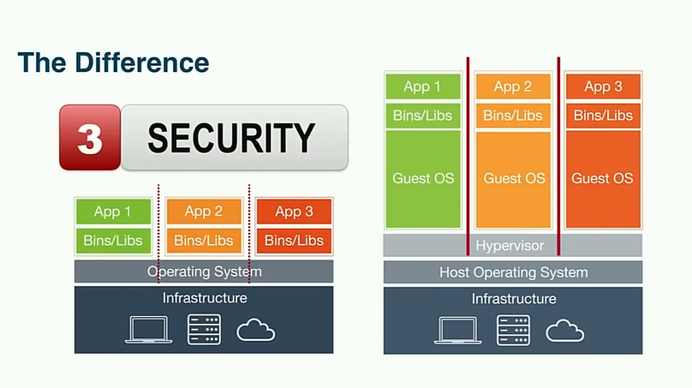
Security and Isolation

Slide 16

Performance

Slide 17
Companies Provides Containers
Docker
Google-Kubernetes
CareOS
RedHat
Microsoft
Amazon
IBM
VMware

Slide 18
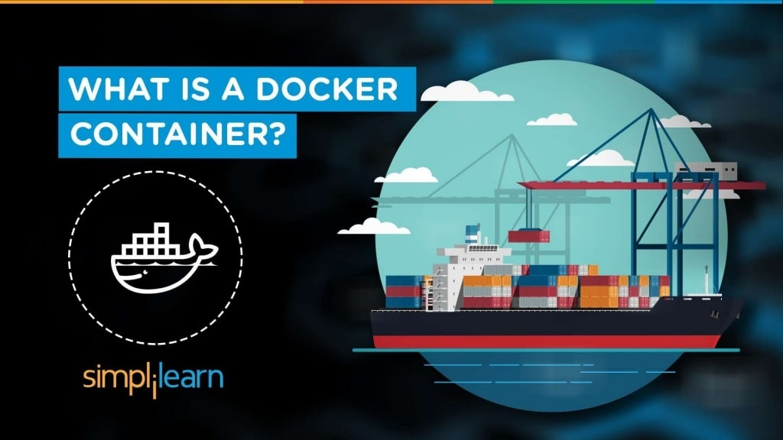

Slide 19
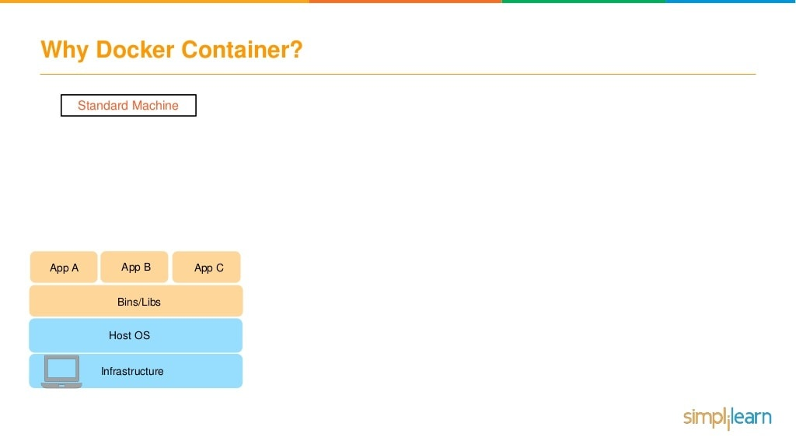

Slide 20
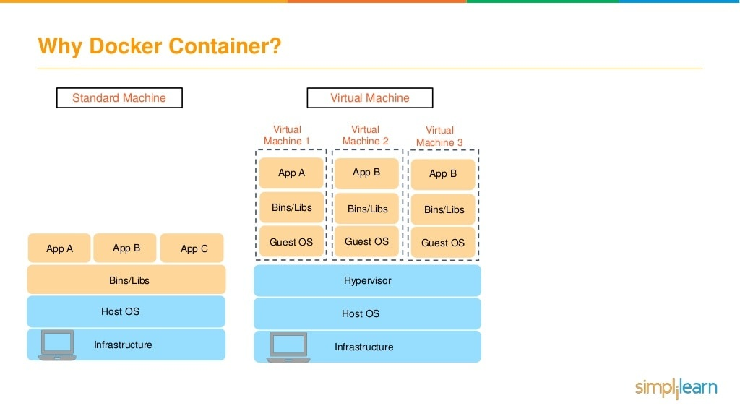

Slide 21
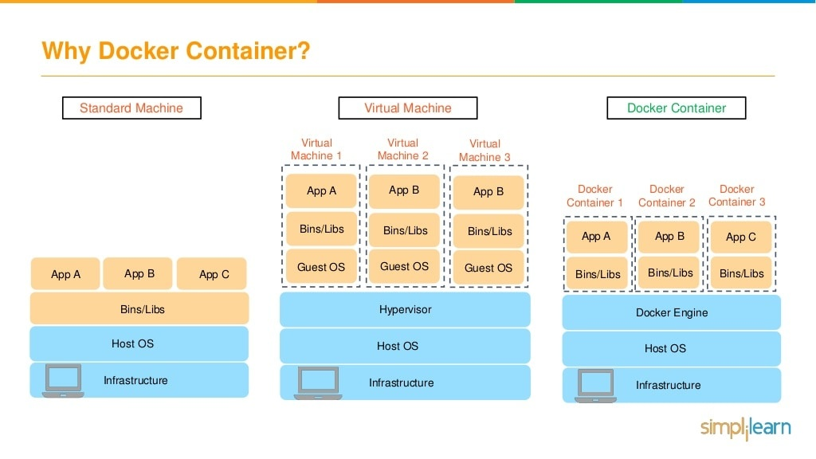

Slide 22
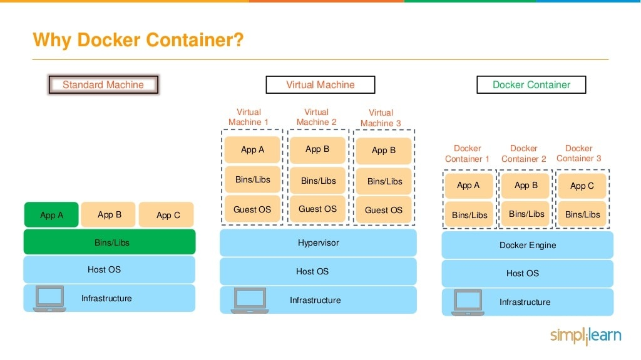

Slide 23
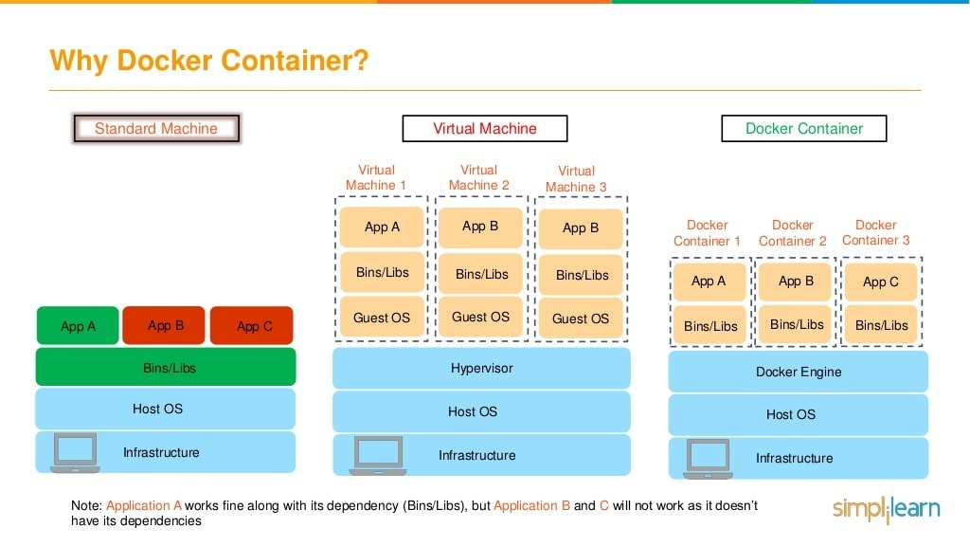

Slide 24
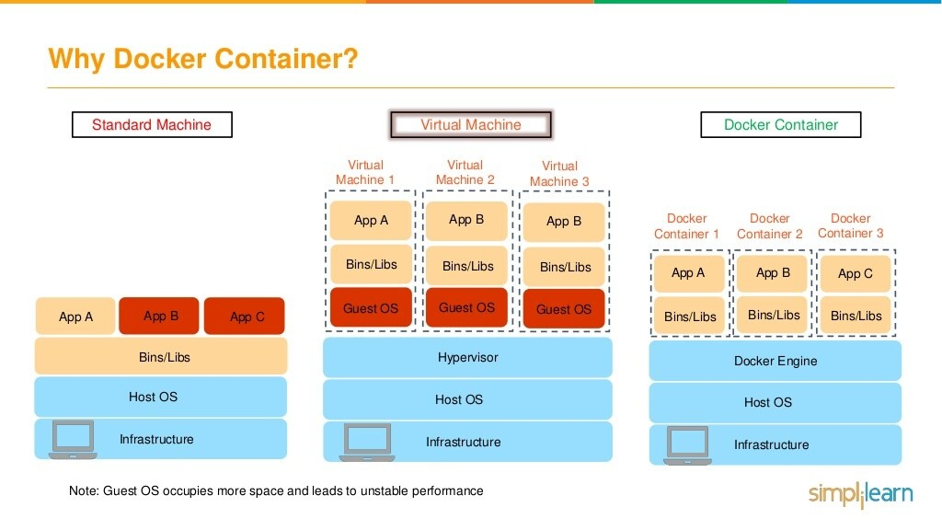

Slide 25
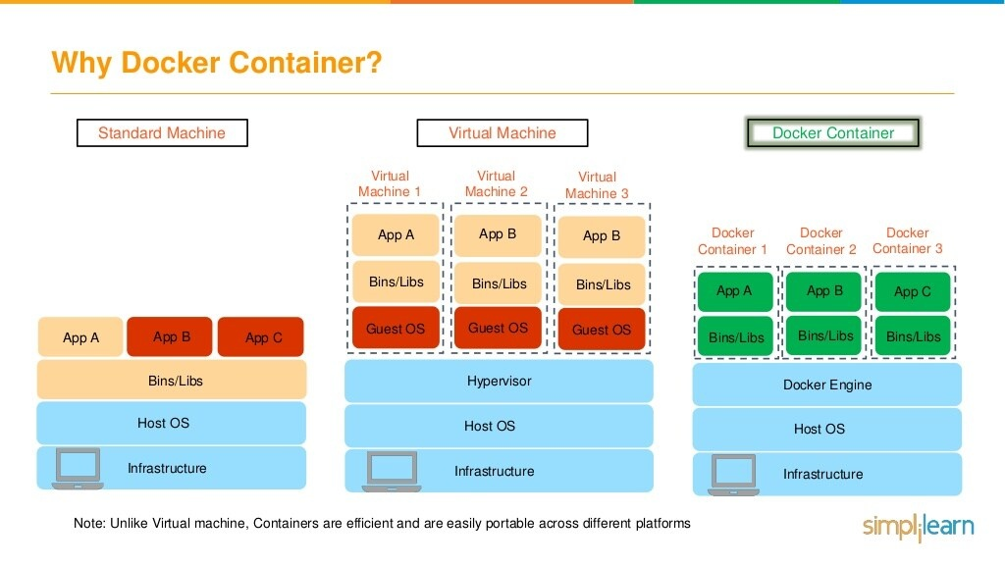

Slide 26
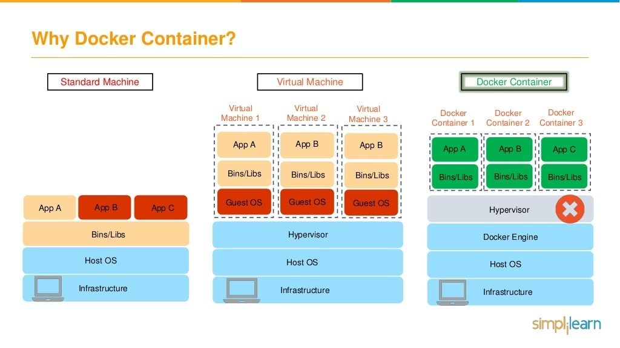

Slide 27
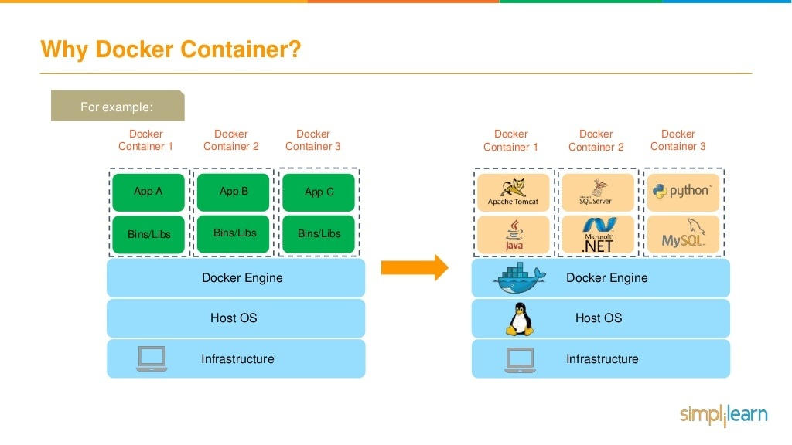

Slide 28
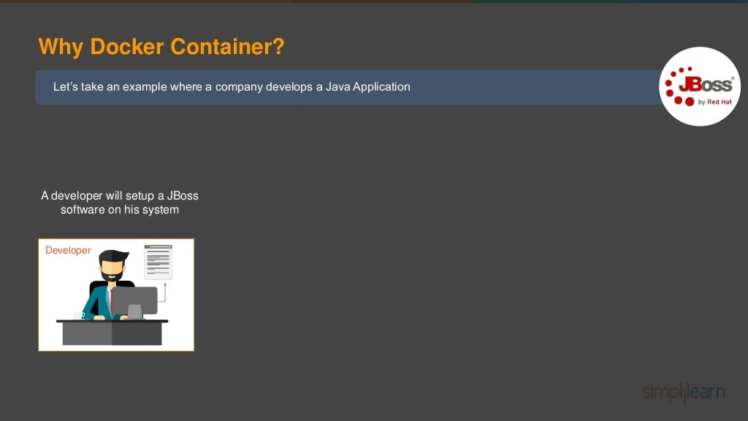

Slide 29
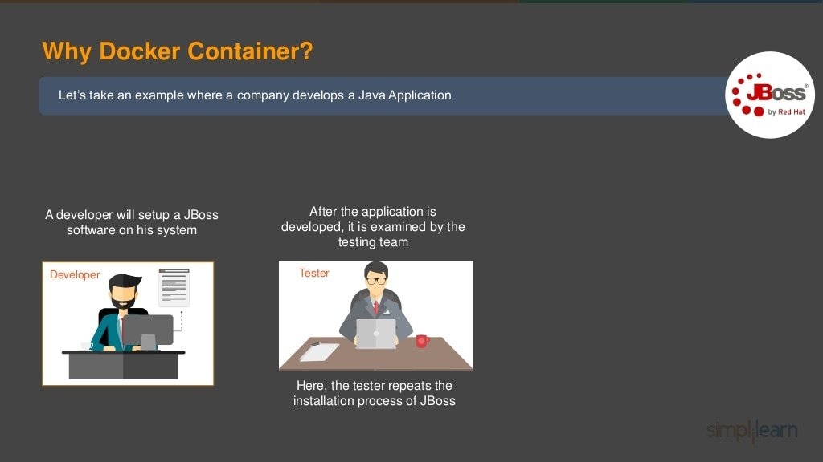

Slide 30
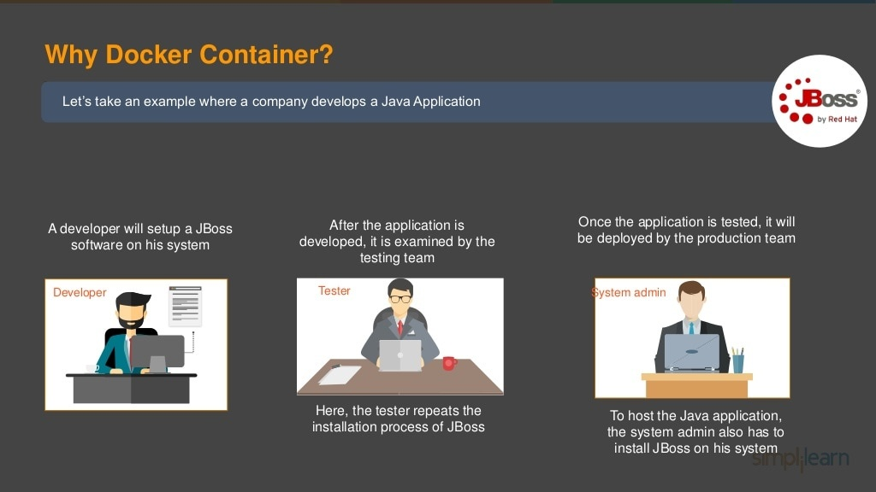

Slide 31
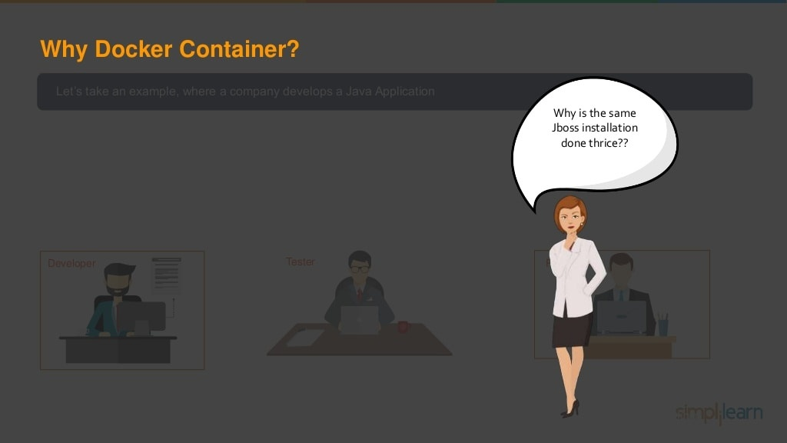

Slide 32
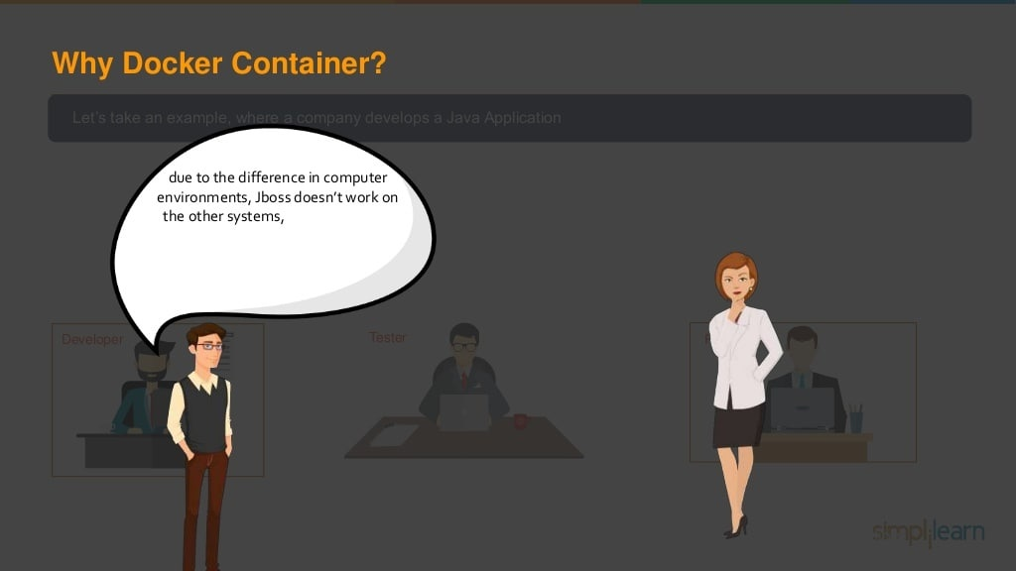

Slide 33
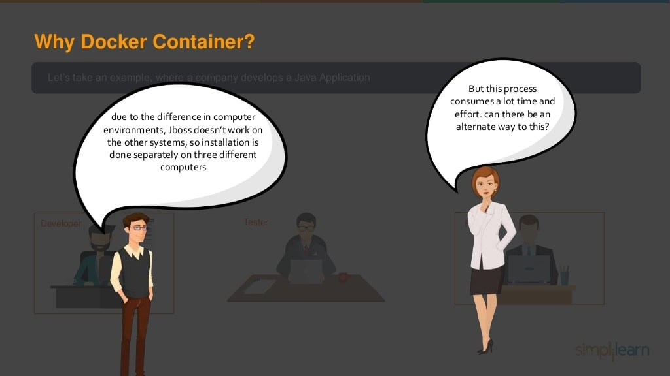

Slide 34
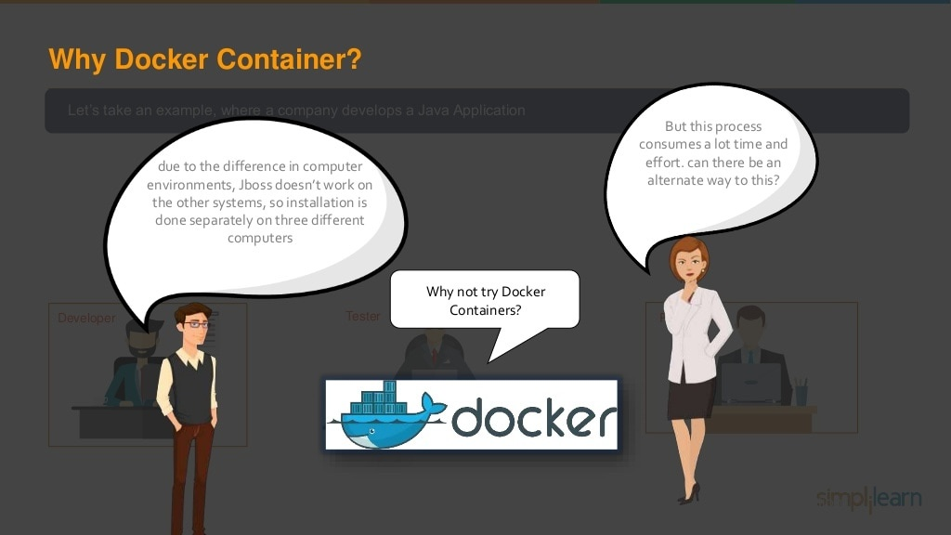

Slide 35
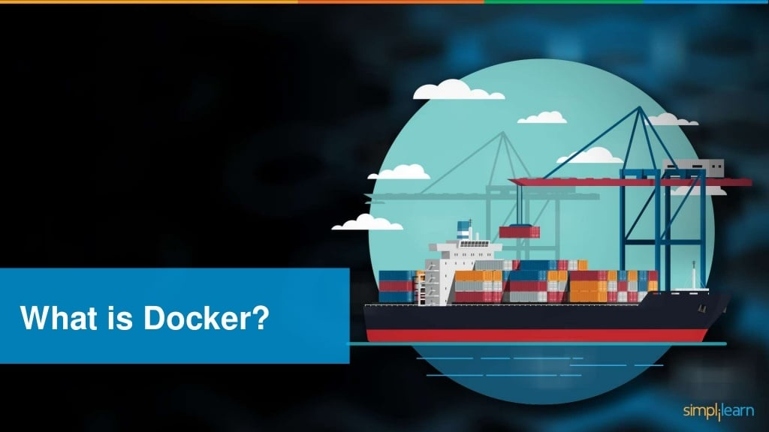

Slide 36
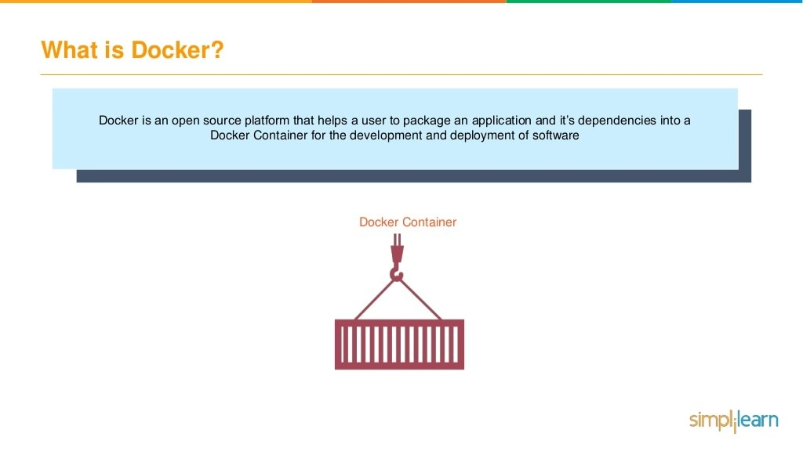

Slide 37
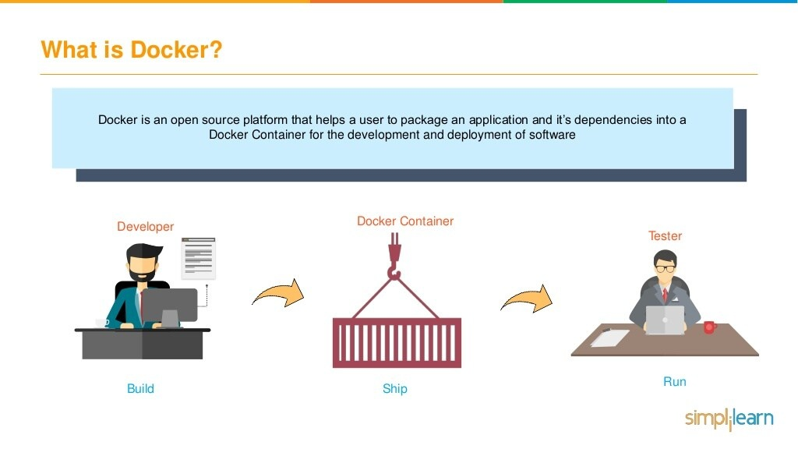

Slide 38
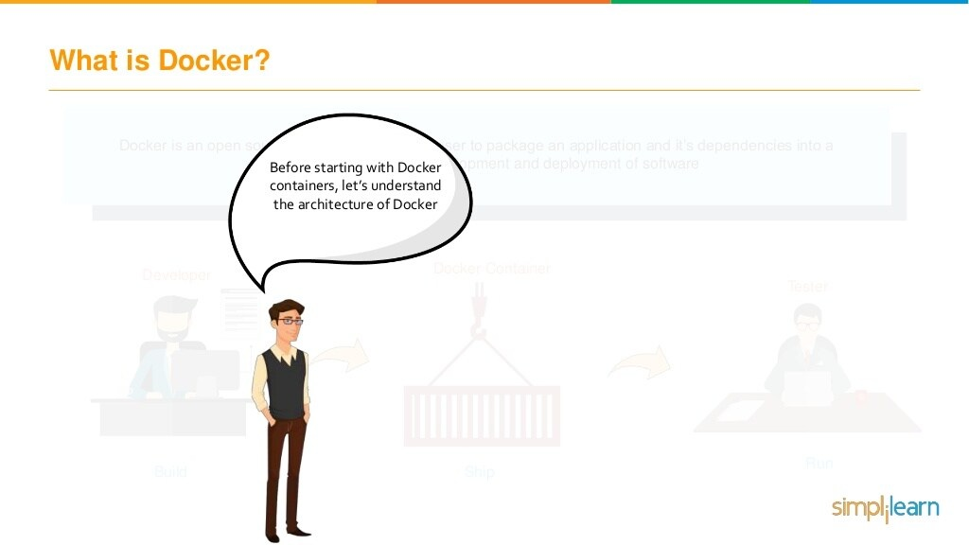

Slide 39
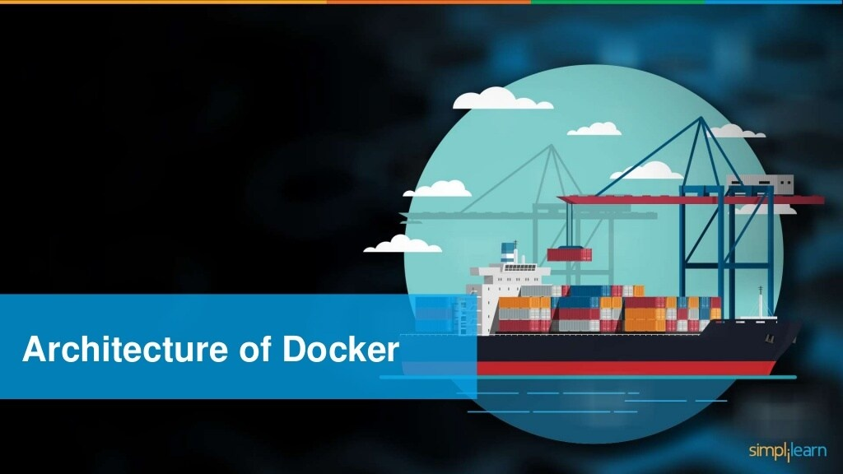

Slide 40
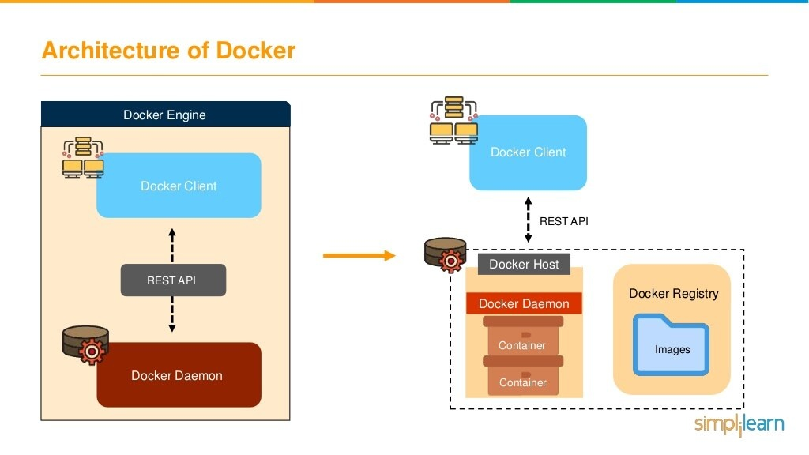

Slide 41
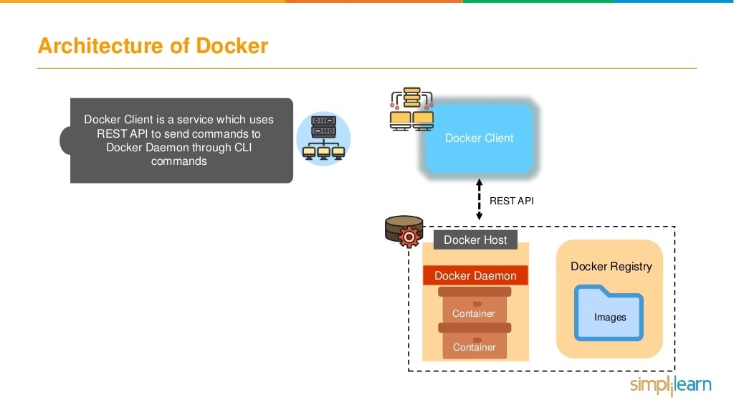

Slide 42
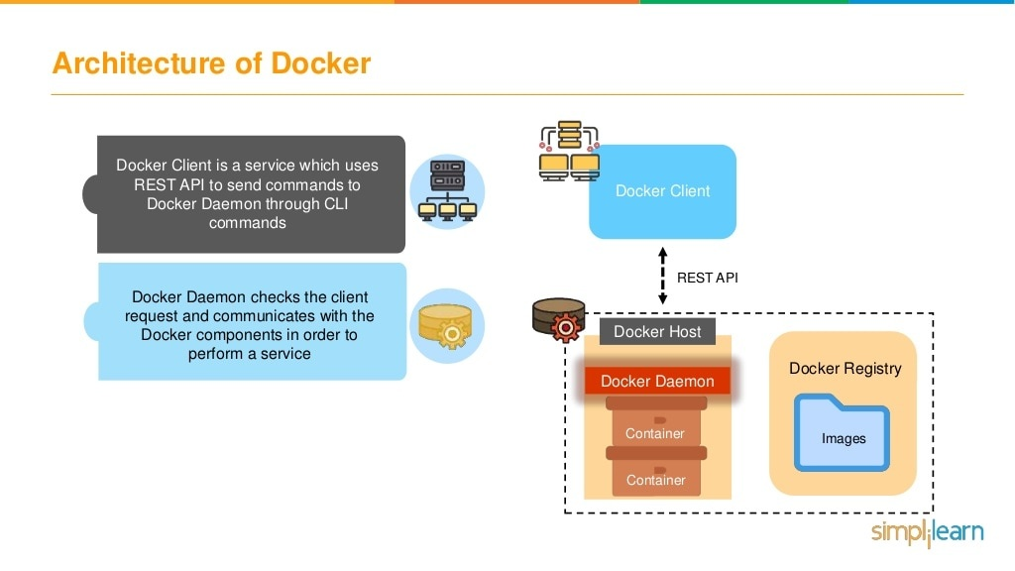

Slide 43
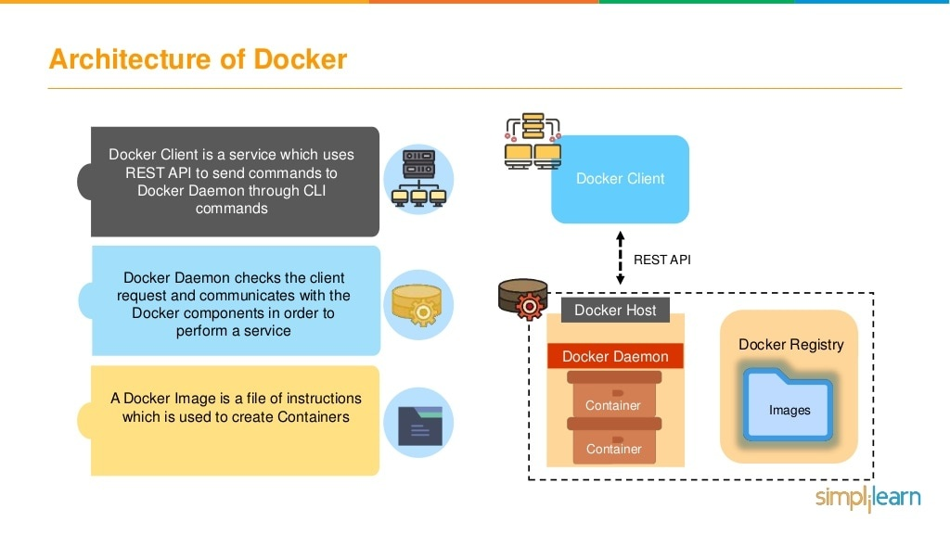

Slide 44
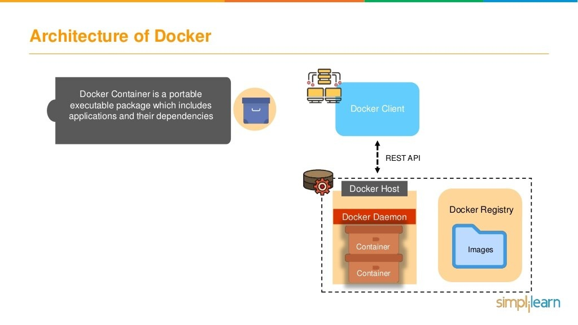

Slide 45
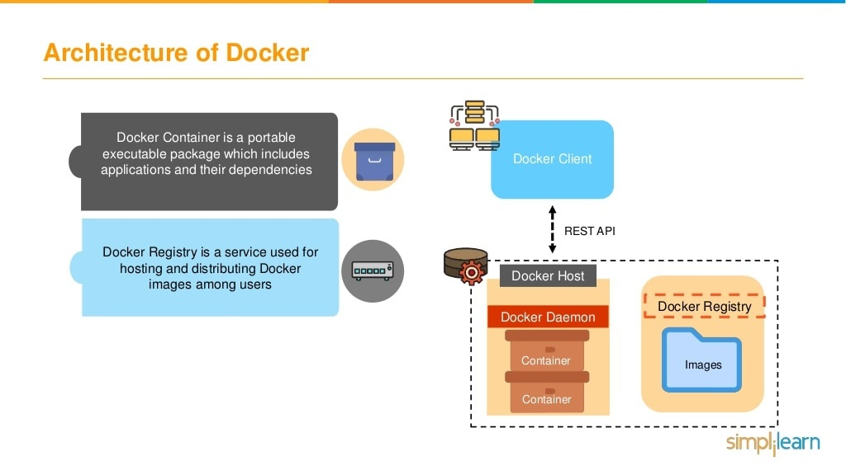

Slide 46
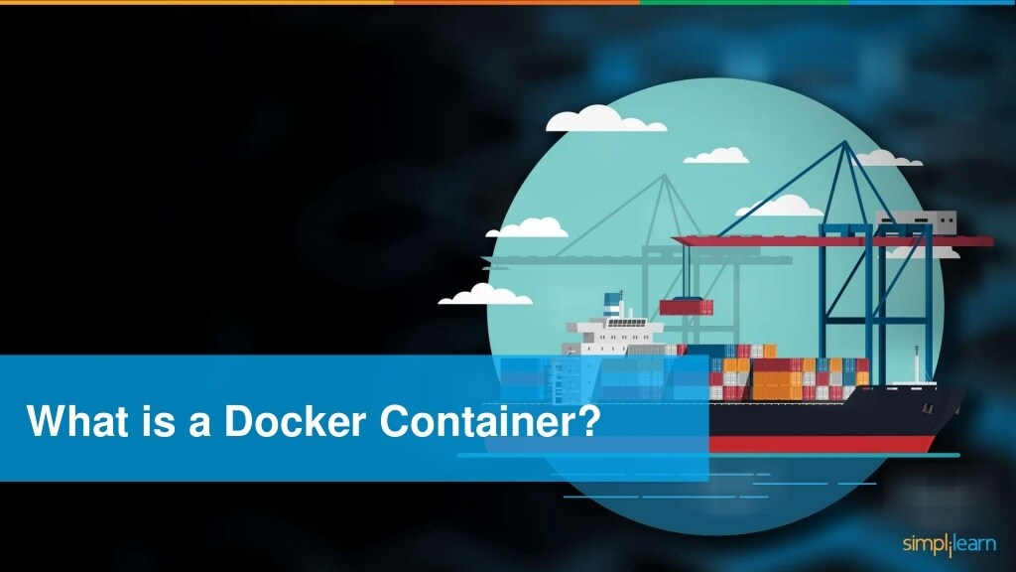

Slide 47
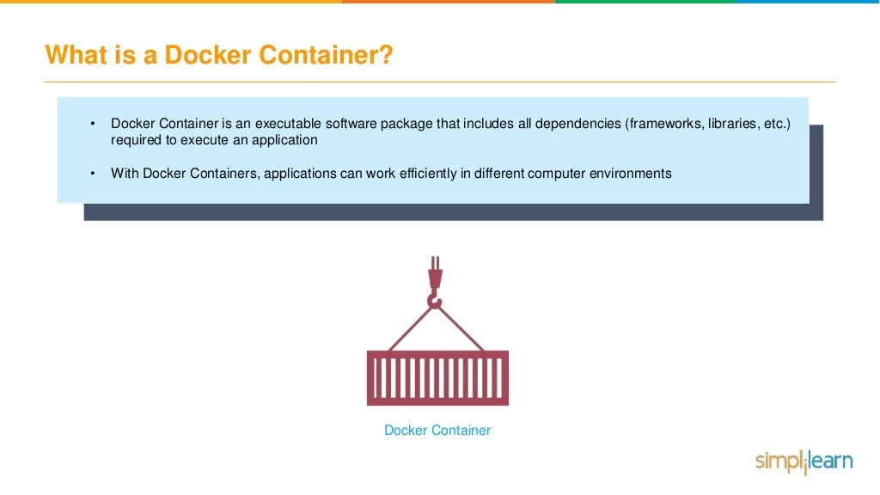

Slide 48
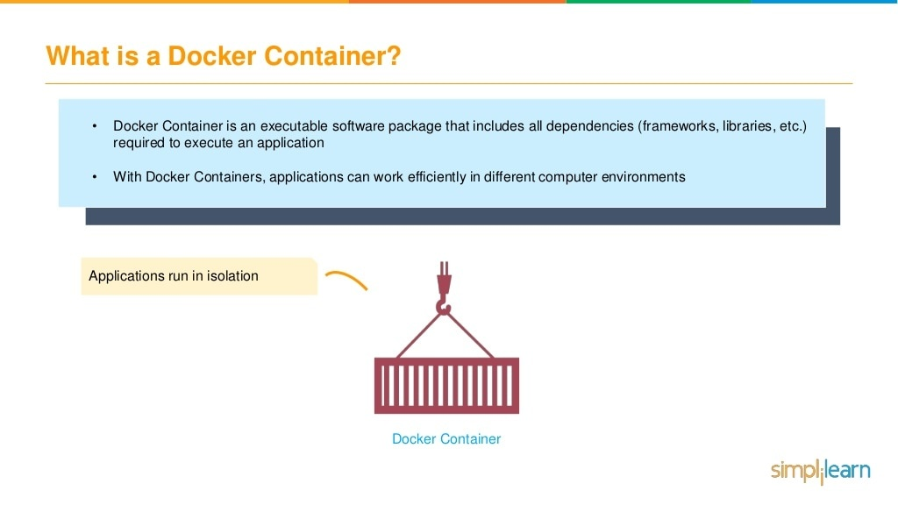

Slide 49
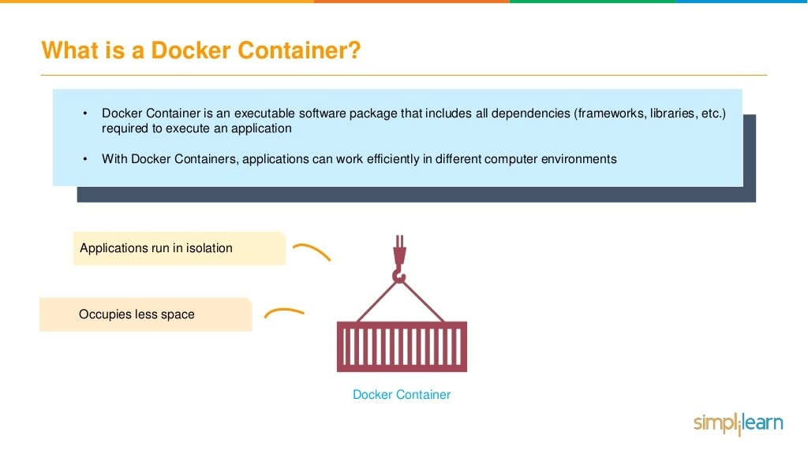

Slide 50
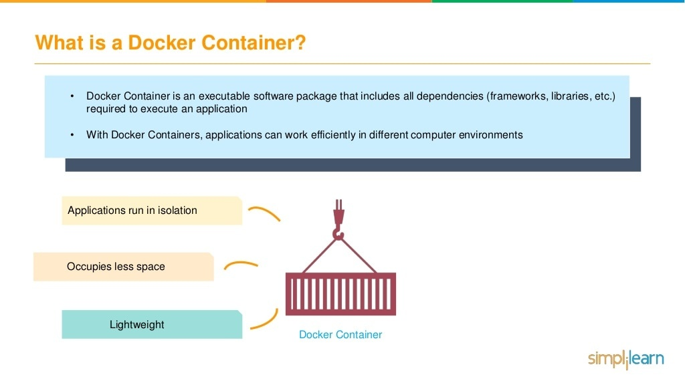

Slide 51
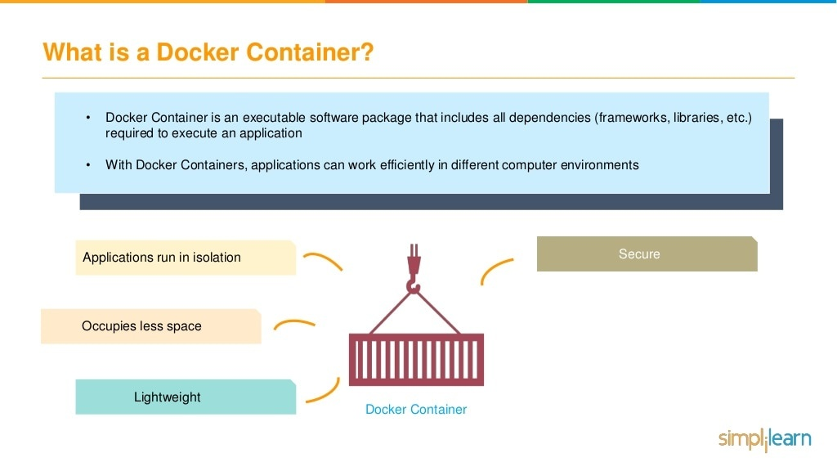

Slide 52
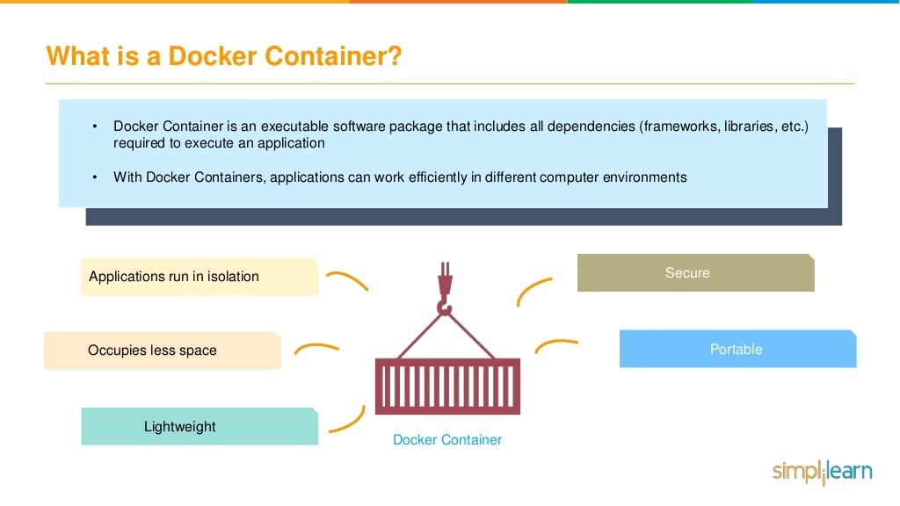

Slide 53
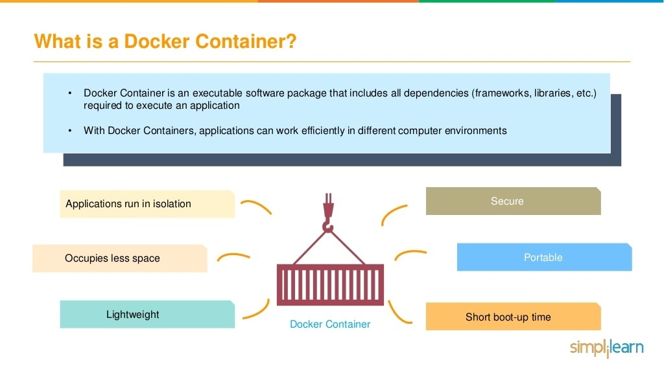

Slide 54
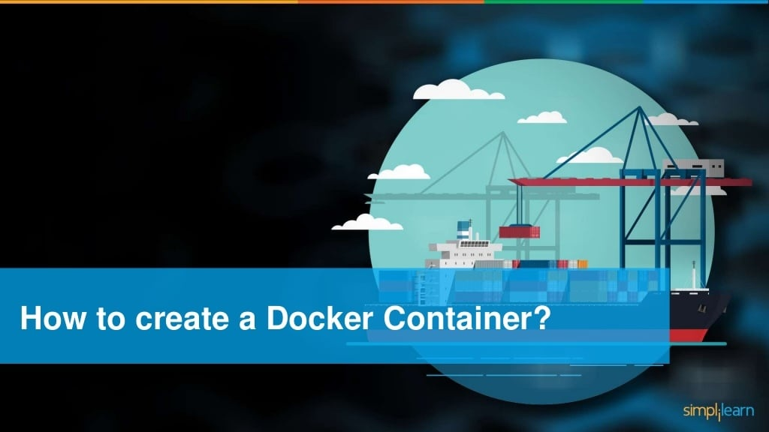

Slide 55
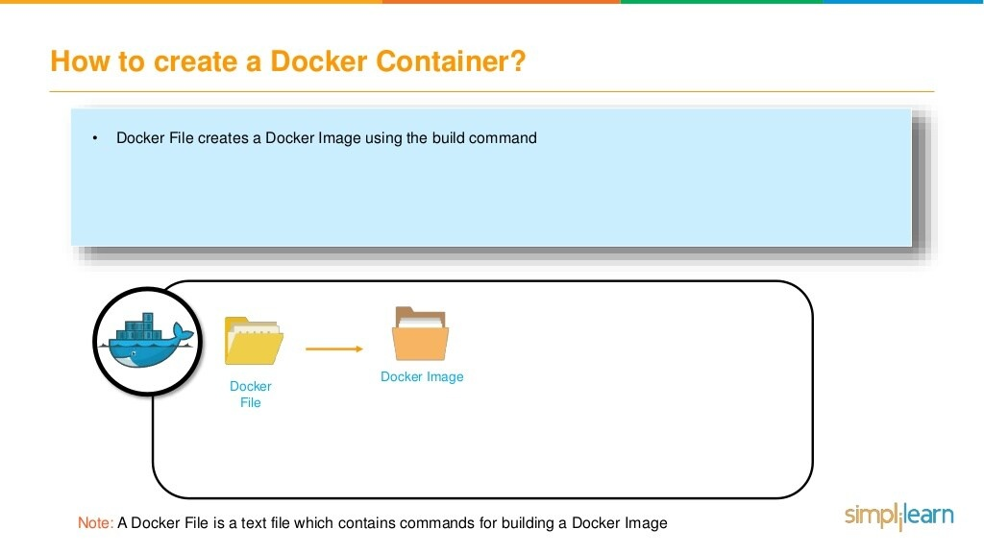

Slide 56
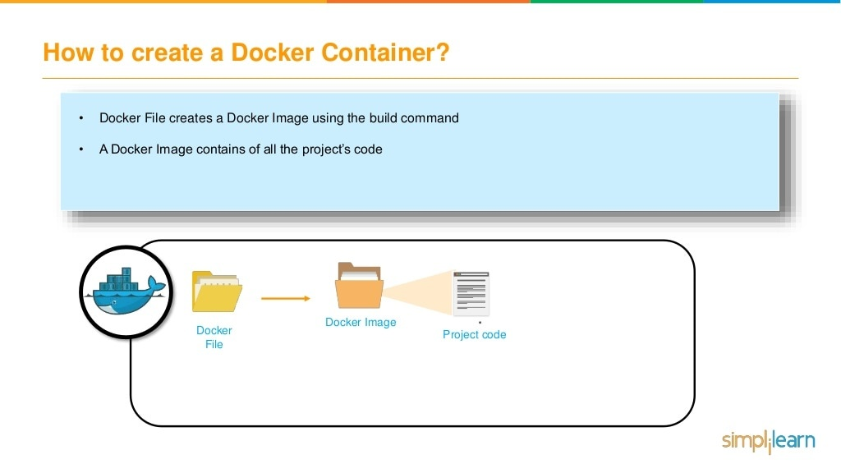

Slide 57
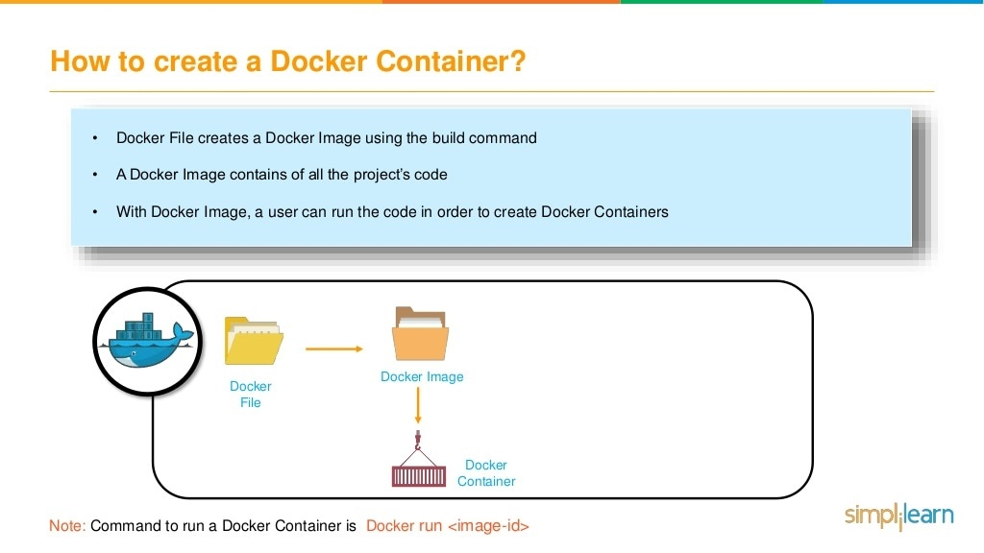

Slide 58
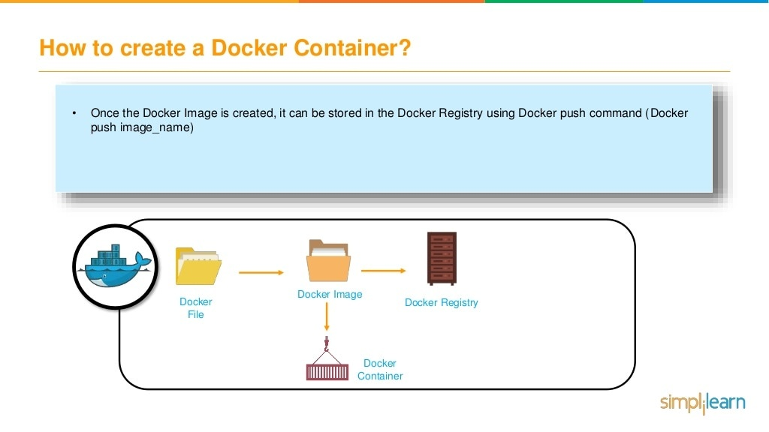

Slide 59
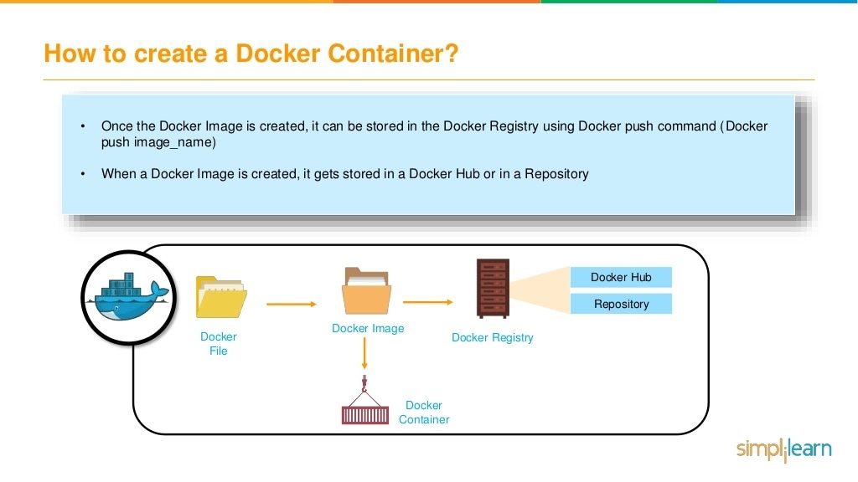

Slide 60
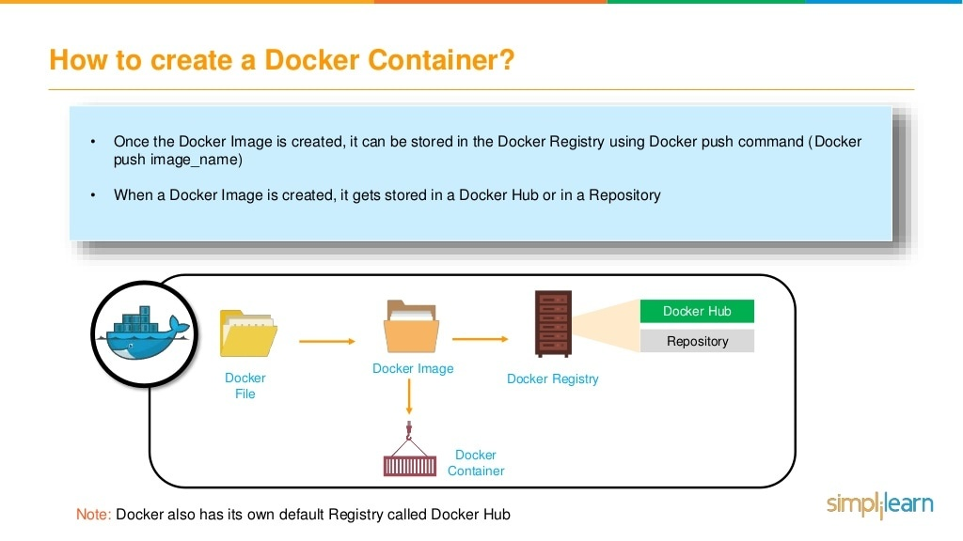

Slide 61
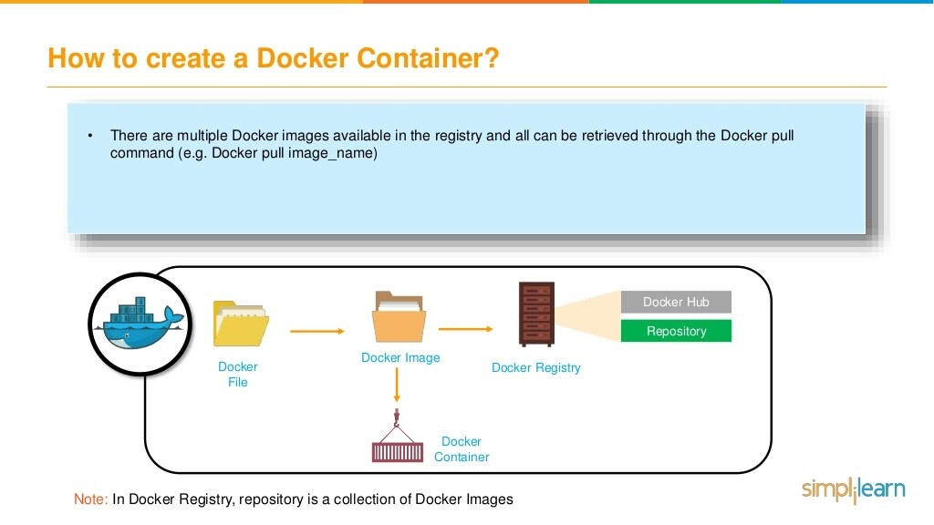

Slide 62
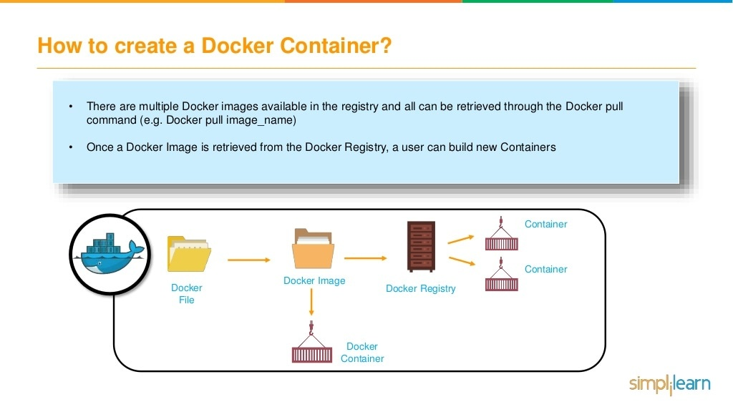

Slide 63
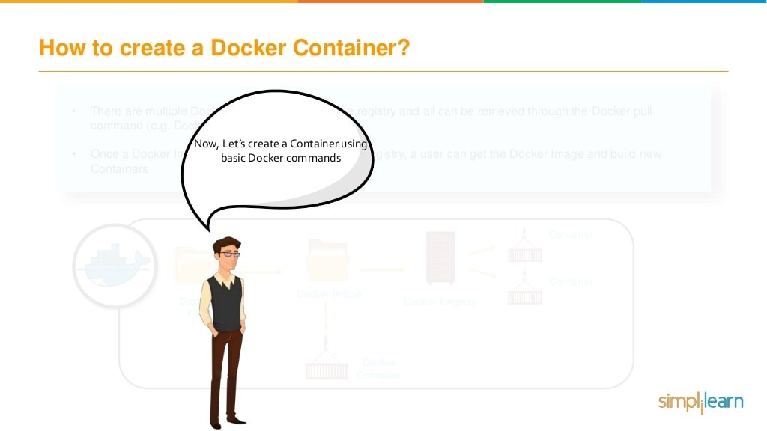

Slide 64
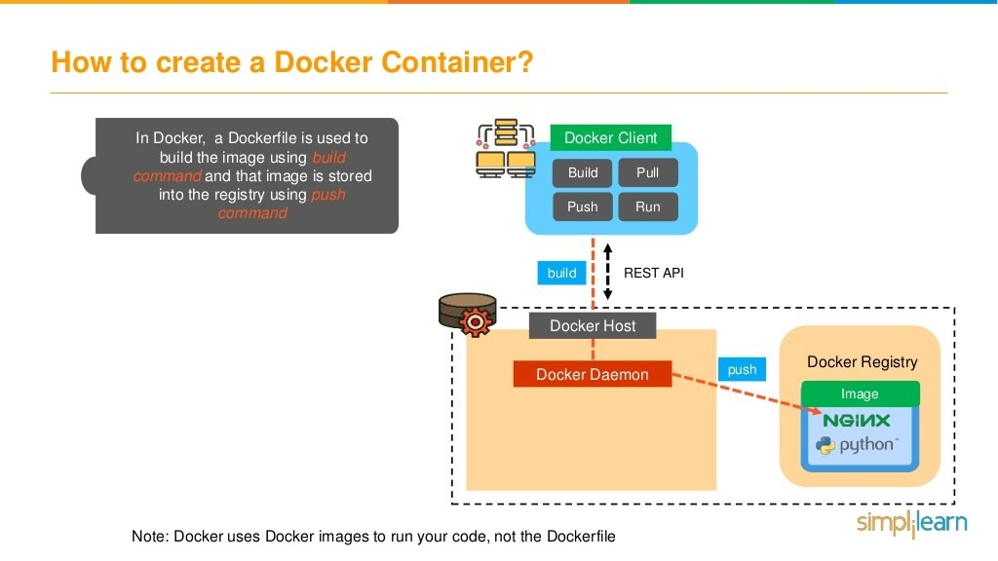

Slide 65


Slide 66


Slide 67


Slide 68


Slide 69


Slide 70


Slide 71


Slide 72


Slide 73


Slide 74


Slide 75


Slide 76


Slide 77
Thank you!
Any Questions???

